Slide 1
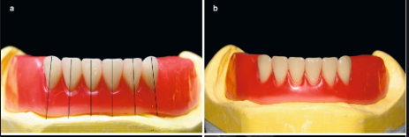
Arrangement of artificial teeth
It is the setting or placement of an artificial teeth on the trail denture. The arrangement of teeth achieved after fixing the record bases on the articulator by mounting.

Slide 2
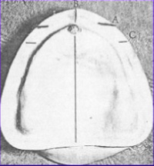
Guiding line said in arrangement of artificial teeth • For maxillary cast
1.A line drawn parallel to the frontal plane and touches the anterior margin of incisive papilla, aid in the positioning of the upper central incisors.

Slide 3
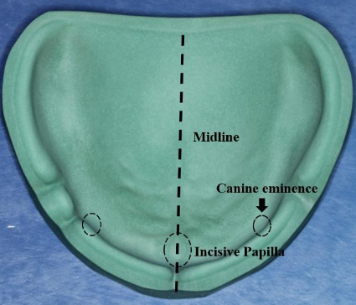
2- The mid line follows the mid palatal suture and bisects the incisive papilla, this line is perpendicular to the line drawn before.
3.The canine eminence line marked on the cast if can be notice.

Slide 4
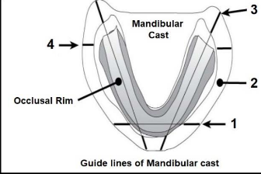
1-A line is drawn parallel to the frontal plane bisecting the residual ridge, aid in the positioning of the mandibular central incisors
For mandibular cast

Slide 5
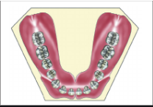
2- A point designates the distal of mandibular canines.
3-A line follow the crest of the residual ridge extended from the canine point to the middle of retro molar pad, aids in the bucco-lingual position of the mandibular posterior teeth.

Slide 6
4- A line that bisects the vertical height of the retromolar pad aids in the establishing the vertical position of the occlusal surfaces of the posterior teeth.

Slide 7
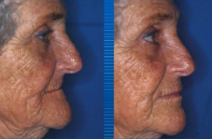
(Arrangement of anterior teeth) The anterior teeth should be arranged to provide the following requirements:
1.Proper lip support.
2.Satisfactory phonetics.
3.Pleasing esthetics.

Slide 8
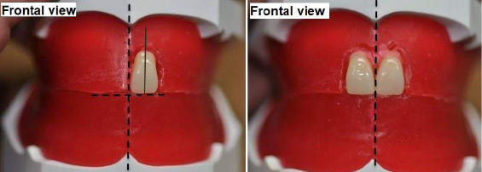
in frontal view: the contact point between right and left central incisors should coincide with the mid-line of cast. The incisal edge of each one should touch the occlusal plane. The long axis is perpendicular to the occlusal plane.
Arrangement of the maxillary anterior teeth
1.Maxillary central incisors

Slide 9
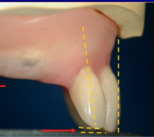
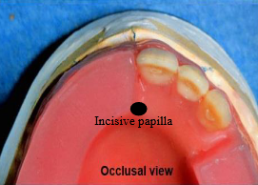
In sagittal view: should have slight labial inclination (5 degrees).
In occlusal view (horizontal plane):the two central incisors should be placed to give the beginning of the curvature of the arch ; generally, the labial surfaces of central incisor located at distance of 8-10 mm from the center of incisive papilla.

Slide 10
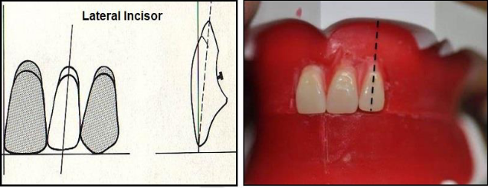
2.Maxillary lateral incisor:
In frontal view, the incisal edge is 1-2mm above the occlusal plane, and the long axis shows a little distal inclination.
In sagittal view, the maxillary lateral incisor should have slight labial inclination (20 degrees).

Slide 11
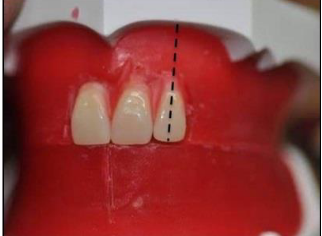
In occlusal view, the cervical area is depressed more than the central incisors, and the distal edge should be rotated lingually to form the arch curvature.

Slide 12
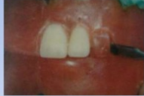
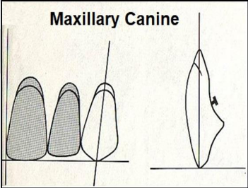
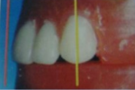
In frontal view, the tip of the canine should touch the occlusal plane, and the long axis is perpendicular to the plane
3.Maxillary canine:

Slide 13
In sagittal view, the long axis is vertical
In occlusal view, the cervical area is prominent. The maxillary canine represents the corner of the mouth, and the turning point of the maxillary arch, also it forms the transition from the anterior teeth to posterior teeth

Slide 14
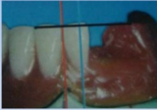
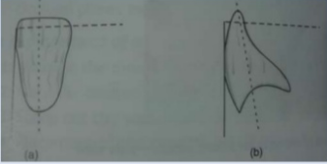
B. Arrangement of mandibular anterior teeth: 1.Mandibular central incisor:
In frontal view, the long axis is vertical. Their mid line should coincide with the maxillary mid line.
In sagittal view, should have slight labial inclination.

Slide 15
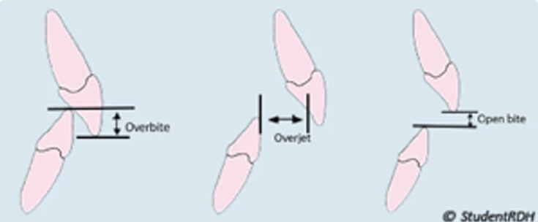
It is the vertical extension of the upper anterior teeth over the lower teeth. 2mm in a vertical direction when the opposing posterior teeth are in contact in centric occlusion.
Overbite (vertical overlap):

Slide 16
Overjet (horizontal overlap): It is the projection of maxillary anterior teeth beyond their antagonist 2mmin a Horizontal Direction.

Slide 17
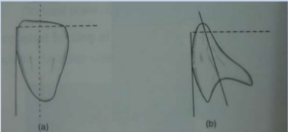
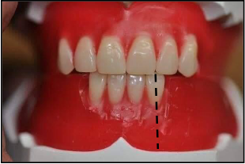
2. Mandibular lateral incisor:
In frontal view, the long axis is vertical to the occlusal plane.
In sagittal view, should have slight labial inclination.

Slide 18
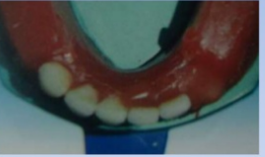
The incisal edge of the Mandibular Lateral incisors should be positioned behind the Maxillary Lateral incisor 2 mm (overbite) and 2mm (overjet). In horizontal view, the distal edge rotated towards lingually to have the arch curvature.

Slide 19
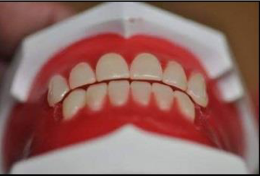
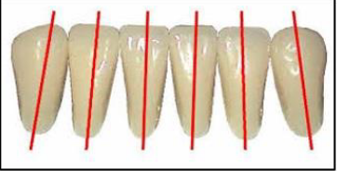
3. Mandibular canine:
In frontal view,
the long axis has slight distal inclination. The tip of lower canine should be place in the embrasure between maxillary lateral incisor and canine.
In sagittal view, the long axis has slight lingual inclination.

Slide 20
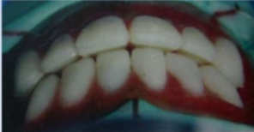
In occlusal view, the cervical area is prominent.
The arrangement of anterior teeth should follow the form of the arch.

